Slide 1
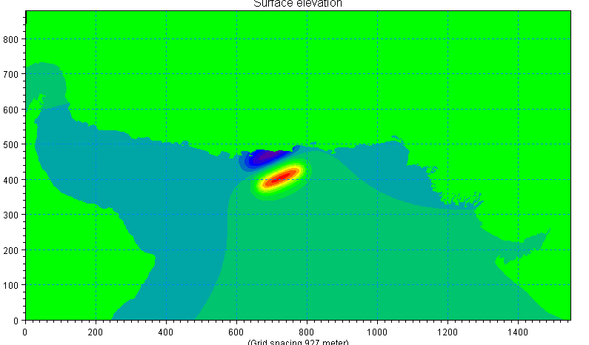
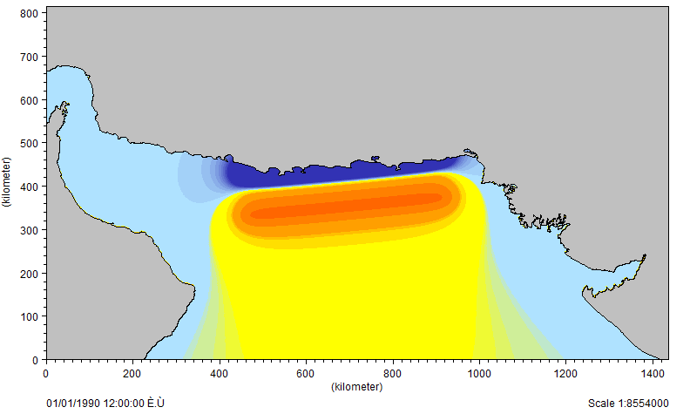
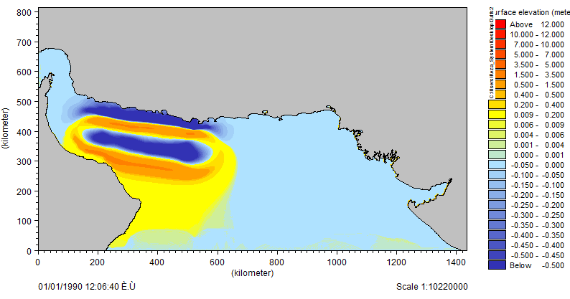
Research and development to set a strategy for safeguarding tsunami effect on Makran coastal facility and along
By :
Reza Zahedinejad

Slide 2
Categories
What a Tsunami is
How are Tsunamis Generated
Distant Tsunami and Local Tsunami
Historical Tsunami in Makran Subduction Zone (MSZ)
Research Methodology
Tsunami Modeling/Animating
Strategy/Concluding Remarks/Recommendations

Slide 3
What a Tsunami is

Slide 4
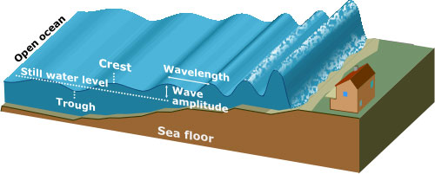
What a Tsunami is
Tsunami is a Japanese word which when translated means a “harbour wave”.
It is a series of waves created when a body of water, such as an ocean, is rapidly displaced.

Slide 5
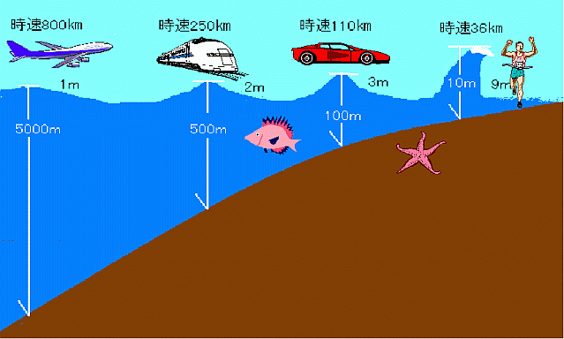
What a Tsunami is
10m/s
36km/hr
30m/s
110km/hr
70m/s
250km/hr
220m/s
800km/hr
Tsunamis consist of a series of long-period waves characterized by very long wave length (up to 100 km) and high speed (up to 760 km/hr) in the deep ocean.
They only become dangerous, when reaching coastal areas where wave height can reach 10 m.

Slide 6
How are Tsunamis Generated

Slide 7
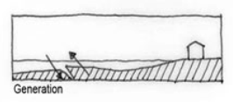
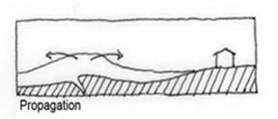
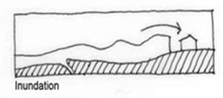
How are Tsunamis Generated
Life of a Tsunami Wave
I) Tsunami Generation
II) Amplification
III) Inundation

Slide 8
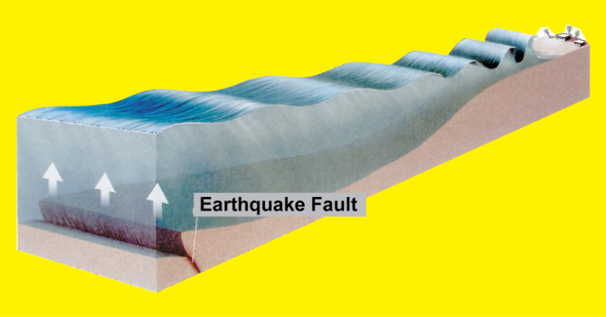
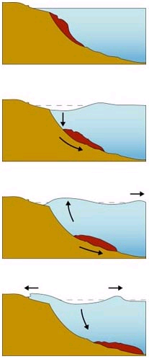
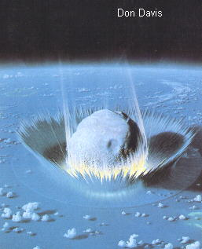
How are Tsunamis Generated
Tsunami Sources
I) Earthquakes
II) Mass Movement
III) Extraterrestrial Impacts

Slide 9
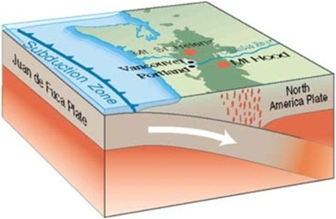
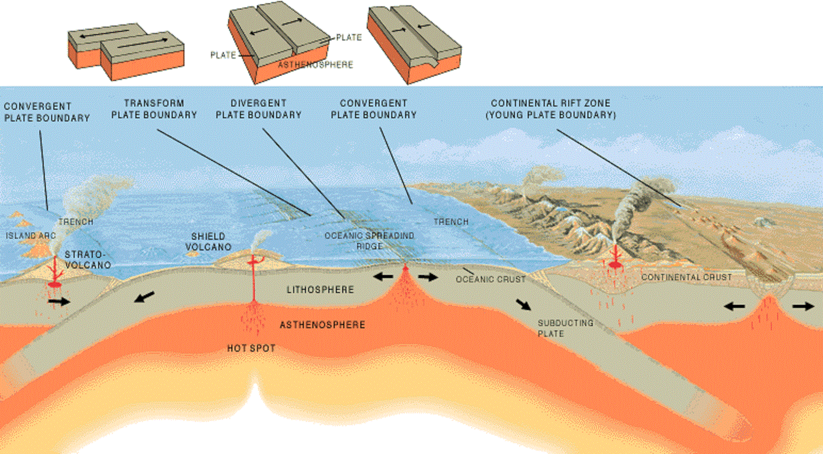
How are Tsunamis Generated
Tsunami Earthquakes
Plate tectonics:
is a scientific theory that describes the large-scale motions of Earth's lithosphere. The lithosphere is broken up into tectonic plates. On Earth, there are seven or eight major plates (depending on how they are defined) and many minor plates. Where plates meet, their relative motion determines the type of boundary: convergent, divergent, or transform.
Subduction:
is the process that takes place at convergent boundaries by which one tectonic plate moves under another tectonic plate and sinks into the mantle as the plates converge. Regions where this process occurs are known as subduction zones. Rates of subduction are typically centimeters per year, with the average rate of convergence being approximately two to eight centimeters per year.

Slide 10
Distant Tsunami and Local Tsunami
Local tsunamis
A tsunami generated near a coast is called “Local Tsunami,” and can hit the coast soon after the earthquake.
Source is near community
Waves arrive within minutes
In earthquake-generated tsunami, likely occurrences prior to wave arrival onto land:
  Strong ground shaking resulting in building damage
  Rapid sea level changes
  Land level changes
  (rupture, subsidence, uplift)
Example: The Makran tsunami
of 1945
The tsunami of 1945 Makran Zone Modeled by MIKE 21 FM

Slide 11
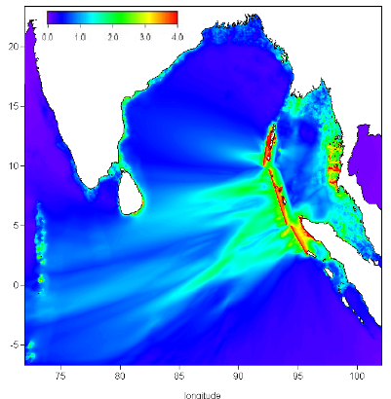
Distant Tsunami and Local Tsunami
Distant Tsunami
A tsunami propagating from afar is called “Distant Tsunami” or Teletsunami.”
Source far from community (1000s km away)
Waves arrive in hours
The 2004 Indian Ocean Tsunami was a local tsunami for Sumatra Island, Indonesia, and was a distant tsunami for Thailand, Sri Lanka and other rim countries of the Indian Ocean.
2004 Indian Ocean Tsunami

Slide 12
Historical Tsunami in Makran Subduction Zone

Slide 13
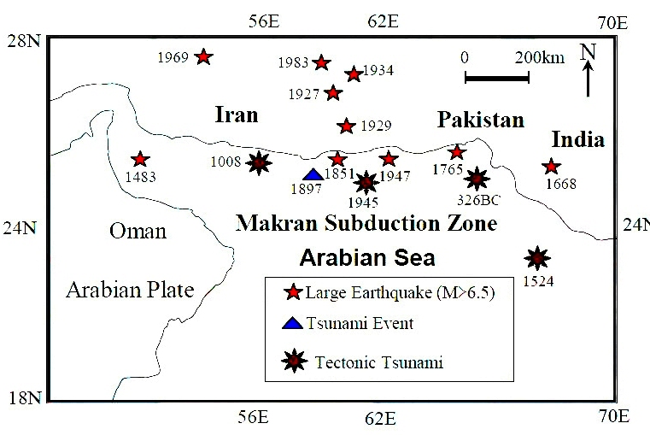
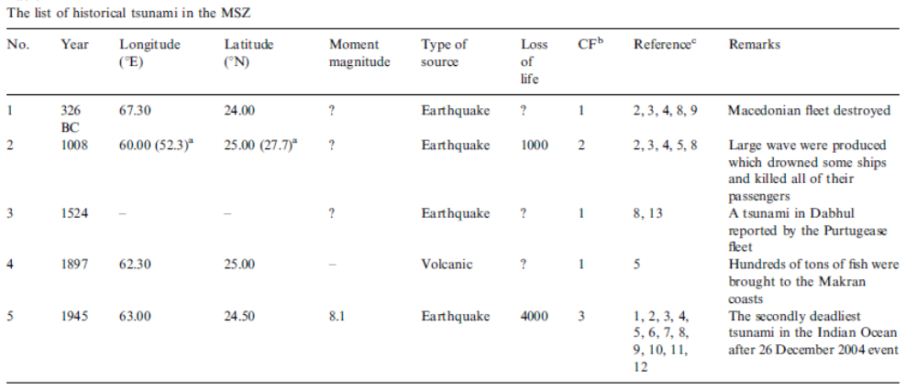
Historical Tsunami in Makran Subduction Zone
Historical Tsunami in Makran Subduction Zone

Slide 14
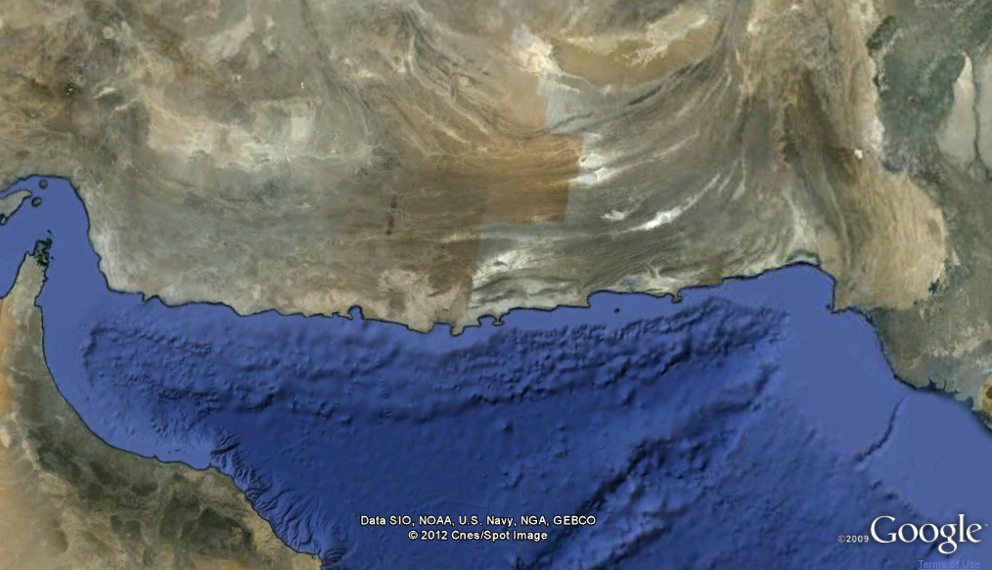
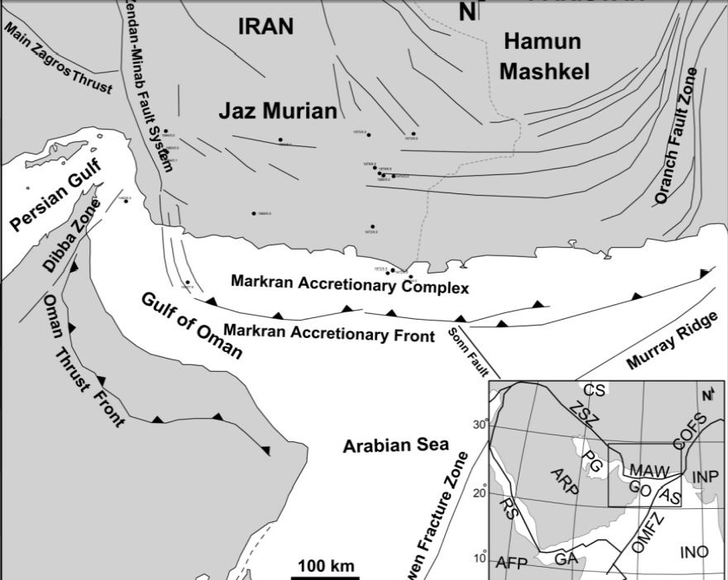
Historical Tsunami in Makran Subduction Zone
Tectonic Setting of Makran Subduction Zone
Characteristics of the Makran Accretionary Complex
Location | Length of Fault | convergence velocity
northwestern Indian Ocean | about 1000 km. | 19.5 to 27 mm/yr

Slide 15
Research Methodology

Slide 16
Research Methodology
Why tsunami modeled?
The following questions can be answered by the tsunami modeling:
tsunami height arrival time along coasts
inundation area
maximum inundation depth
understandings of hydraulic and hydrodynamic characteristics of tsunami
By Tsunami modeling, we can be achieved with the following goals:
preparation of tsunami hazard maps
preparation of tsunami inundation maps in a coastal community
estimation of tsunami hazards in future plan of land use.

Slide 17
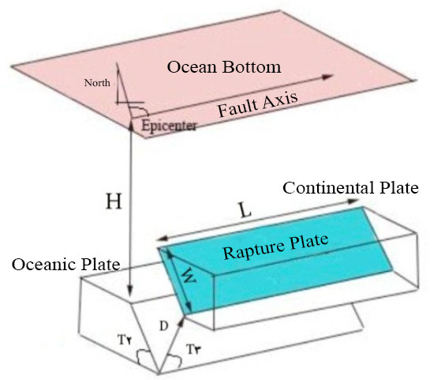
Research Methodology
Parameters required for Modeling Tsunamis Generated by Earthquakes
Name of parameters | Status
-Depth [km] | ☑
-Length [km] | ☑
-Slip angle (deg.) | ☑
-Dip [degrees] | ☑
-Strike [degrees] | ☑
-Width [km] | ☒
-Mean Dislocation [m] | ☒
-Earthquake magnitude [MW] | ☒
Not Available | Available
☒ | ☑

Slide 18
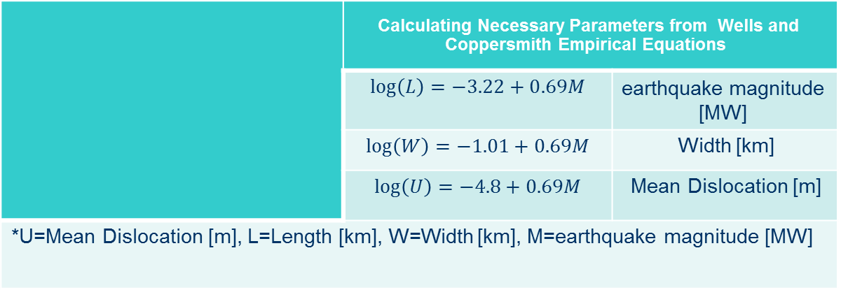
Research Methodology
Generation Phase: Calculating Necessary parameters
Empirical equations of Wells and Coppersmith (1994) were used to estimate the corresponding earthquake magnitude of the fault rupture followed by calculation of the rupture width and surface displacement.
Calculating Necessary Parameters from Wells and Coppersmith Empirical Equations
earthquake magnitude [MW] | $$\log\left(L\right)=−3.22+0.69M$$
Width [km] | $$\log\left(W\right)=−1.01+0.69M$$
Mean Dislocation [m] | $$\log\left(U\right)=−4.8+0.69M$$
*U=Mean Dislocation [m], L=Length [km], W=Width [km], M=earthquake magnitude [MW]

Slide 19
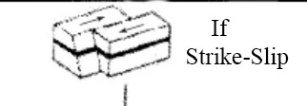
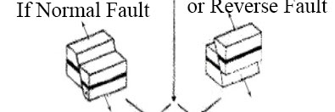
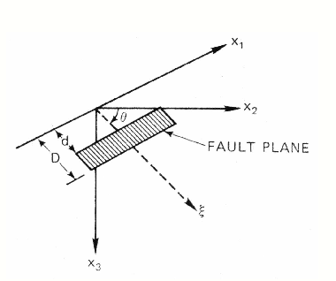
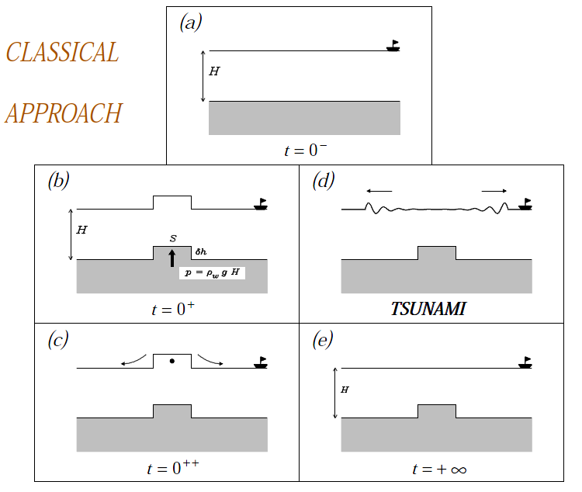
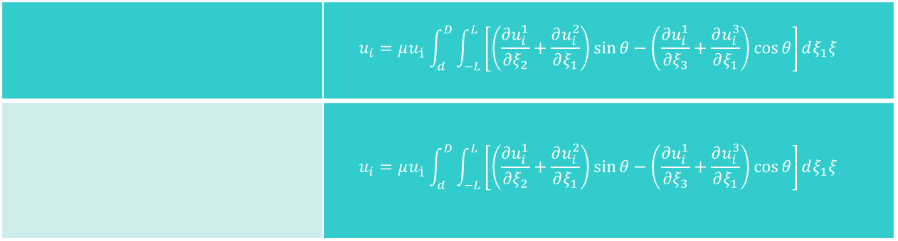
Research Methodology
The algorithm of Mansinha and Smylie to calculate the seafloor deformation
$$u_{i}=μu_{\dot{1}}\int_{d}^{D}{\int_{−L}^{L}{\left[\left(\frac{∂u_{i}^{1}}{∂ξ_{2}}+\frac{∂u_{i}^{2}}{∂ξ_{1}}\right)\sin{θ}−\left(\frac{∂u_{i}^{1}}{∂ξ_{3}}+\frac{∂u_{i}^{3}}{∂ξ_{1}}\right)\cos{θ}\right]dξ_{1}ξ}}$$
$$u_{i}=μu_{\dot{1}}\int_{d}^{D}{\int_{−L}^{L}{\left[\left(\frac{∂u_{i}^{1}}{∂ξ_{2}}+\frac{∂u_{i}^{2}}{∂ξ_{1}}\right)\sin{θ}−\left(\frac{∂u_{i}^{1}}{∂ξ_{3}}+\frac{∂u_{i}^{3}}{∂ξ_{1}}\right)\cos{θ}\right]dξ_{1}ξ}}$$

Slide 20
Research Methodology
DHI MIKE ZERO-Introduction
MIKE Zero is the common name of DHI's fully Windows integrated graphical user interface for setting up simulations, pre- and post-processing analysis, presentation and visualization within a project oriented environment. Presently, the MIKE Zero framework gives access to the following DHI modelling systems:
MIKE 11 - a 1D modelling system for rivers and channels
MIKE 21 - a 2D modelling system for estuaries, coastal water and seas
MIKE 3 - a 3D modelling system for deep seas, estuaries and coastal waters
MIKE 21/3 Integrated Models(1)
MIKE FLOOD - a 1D-2D modelling system for inland flood and urban flood studies
LITPACK - a modelling system for littoral processes and coastline kinetics
MIKE SHE - a modelling system for coupled groundwater and surface water resources

Slide 21
Research Methodology
DHI MIKE21-Introduction
MIKE 21 is the ultimate Swiss army knife of coastal modelling. MIKE 21 almost certainly has the tool to simulate physical, chemical or biological processes in coastal or marine areas
Typical MIKE 21 applications:
Design data assessment for coastal and offshore structures
Optimization of port layout and coastal protection measures
Cooling water, desalination and recirculation analysis
Optimization of coastal outfalls
Environmental impact assessment of marine infrastructures
Ecological modelling including optimization of aquaculture systems
Optimization of renewable energy systems
Water forecast for safe marine operations and navigation
Coastal flooding and storm surge warnings
Inland flooding and overland flow modelling

Slide 22
Research Methodology
DHI MIKE21 Modules-Introduction
Modeling of sediments and morphological processes
Coastal areas, seas and river channel hydraulics and morphology
Mike21 ST
Mike21 PT
Mike21 TR
Mike21 ST
Mike21 HD
Mike21C
Ecological studies
Modeling of waves
ECO Lab/Oil Spill Module
Mike21 BW
Mike21 EMS
Mike21 PMS
Mike21 NSW
Mike SW

Slide 23
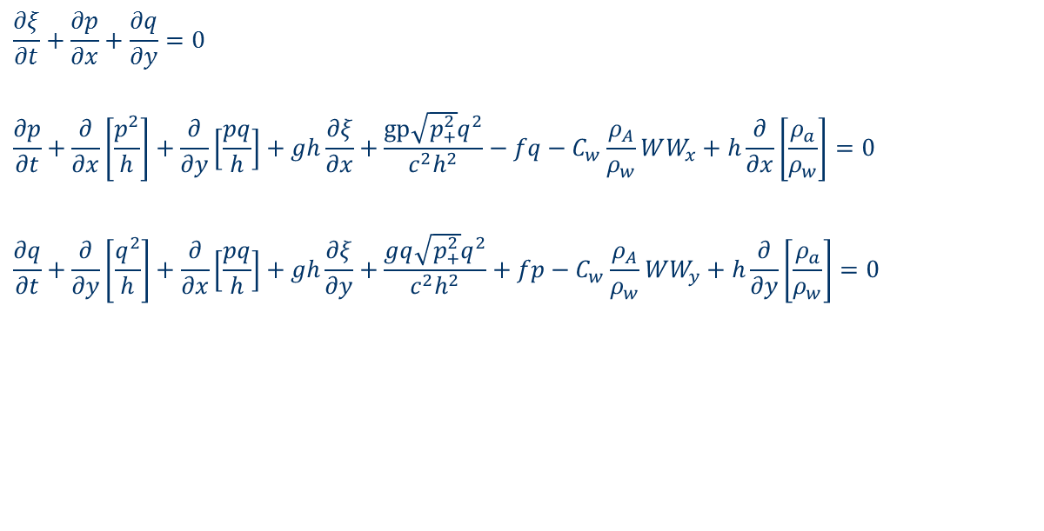
Research Methodology
Propagation Phase: MIKE 21 HD Main Equations
The flow model is two-dimensional hydrodynamic simulation program which calculates unsteady flow resulting from tidal and meteorological forcing on rectilinear grid. The model solves the non-linear shallow water equations on a dynamically coupled system of nested grid using finite difference numerical scheme. The basic partial differential equations are the depth integrated continuity and momentum equations (shallow water equations):
$$\frac{∂ξ}{∂t}+\frac{∂p}{∂x}+\frac{∂q}{∂y}=0$$
$$\frac{∂p}{∂t}+\frac{∂}{∂x}\left[\frac{p^{2}}{h}\right]+\frac{∂}{∂y}\left[\frac{pq}{h}\right]+gh\frac{∂ξ}{∂x}+\frac{gp\sqrt{p_{+}^{2}}q^{2}}{c^{2}h^{2}}−fq−C_{w}\frac{ρ_{A}}{ρ_{w}}WW_{x}+h\frac{∂}{∂x}\left[\frac{ρ_{a}}{ρ_{w}}\right]=0$$
$$\frac{∂q}{∂t}+\frac{∂}{∂y}\left[\frac{q^{2}}{h}\right]+\frac{∂}{∂x}\left[\frac{pq}{h}\right]+gh\frac{∂ξ}{∂y}+\frac{gq\sqrt{p_{+}^{2}}q^{2}}{c^{2}h^{2}}+fp−C_{w}\frac{ρ_{A}}{ρ_{w}}WW_{y}+h\frac{∂}{∂y}\left[\frac{ρ_{a}}{ρ_{w}}\right]=0$$

Slide 24
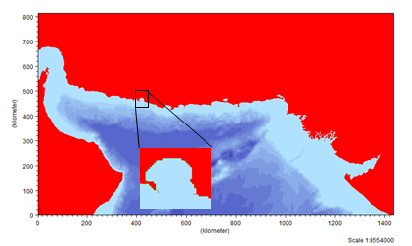
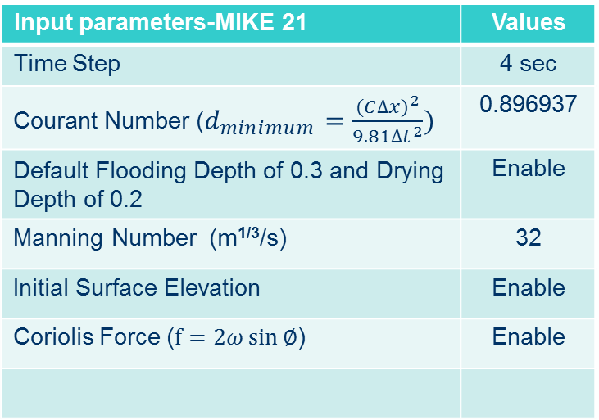
Research Methodology
Input Parameters-MIKE 21
Information of grids resolution
 | Grid spacing (meter) | Grid numbers
Coarse grid (Indian Ocean and Oman Sea) | Dx=927 Dy=927 | 1549x879
Fine grid (Chabahar Bay) | Dx=309 Dy=309 | 99x99
Input parameters-MIKE 21 | Values
Time Step | 4 sec
Courant Number ($d_{minimum}=\frac{{(C∆x)}^{2}}{9.81{∆t}^{2}})$ | 0.896937
Default Flooding Depth of 0.3 and Drying Depth of 0.2 | Enable
Manning Number (m^{1/3}/s) | 32
Initial Surface Elevation | Enable
Coriolis Force ($f=2ω\sin{∅}$) | Enable

Slide 25
Tsunami Modeling/Animating

Slide 26
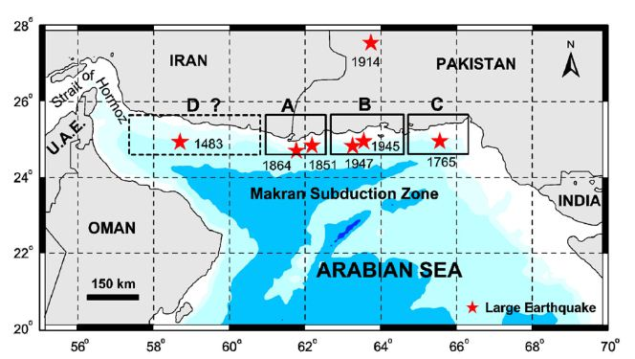
Tsunami Modeling
Scenarios of tsunami
First scenario: Blocks A, B, and C - With approximate length of 500 Km –Eastern Makran Zone
Second scenario: Block D - With approximate length of 400 Km – Western Makran Zone

Slide 27

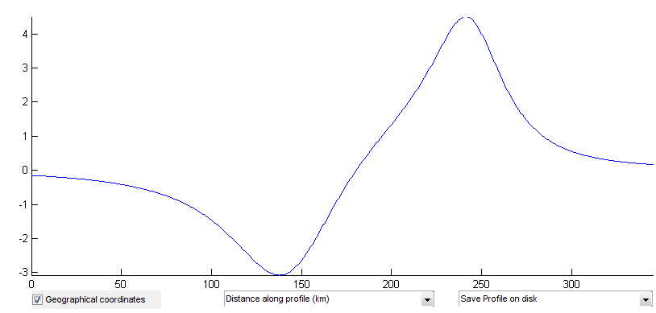
Tsunami Modeling
First scenario: Propagation of tsunami-Earthquake magnitude:8.8 MW-Eastern Makran
Magnitude (Mw) | Length (km) | Width (Km) | Depth (Km) | Mean Dislocation (m) | Slip (Deg) | Dip (Deg) | Strike (Deg)
8.8 | 500 | 100 | 13 | 25 | 7 | 90 | 265
M
Km
The initial tsunami wave profile
Section A-A

Slide 28
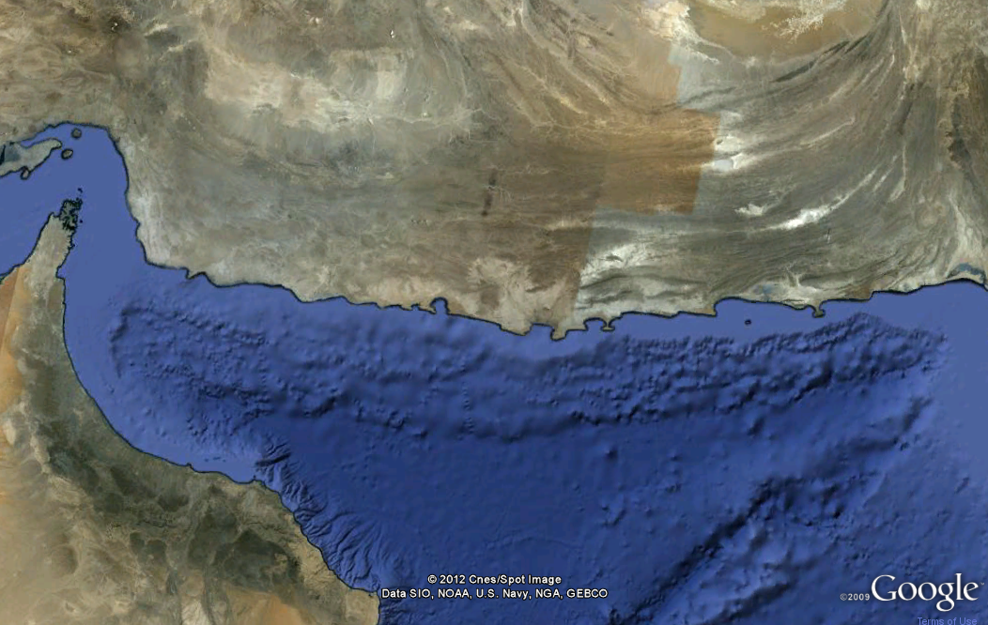
Tsunami Modeling
Location of gauge points
Pasni
Jask Port
Chabahar Bay
Gwadar

Slide 29
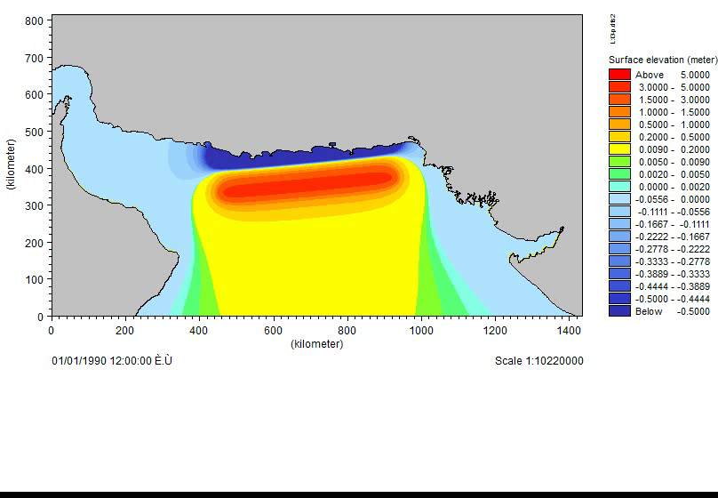
Tsunami Modeling
Tsunami Propagation Video: Eastern Makran Subduction Zone

Slide 30
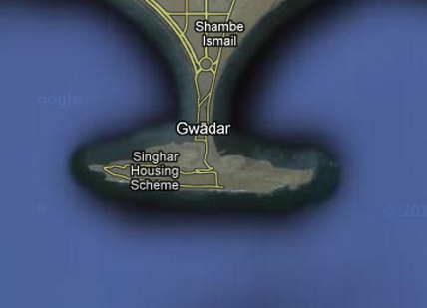
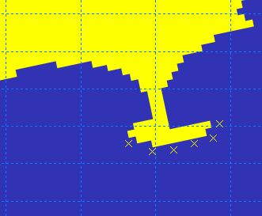
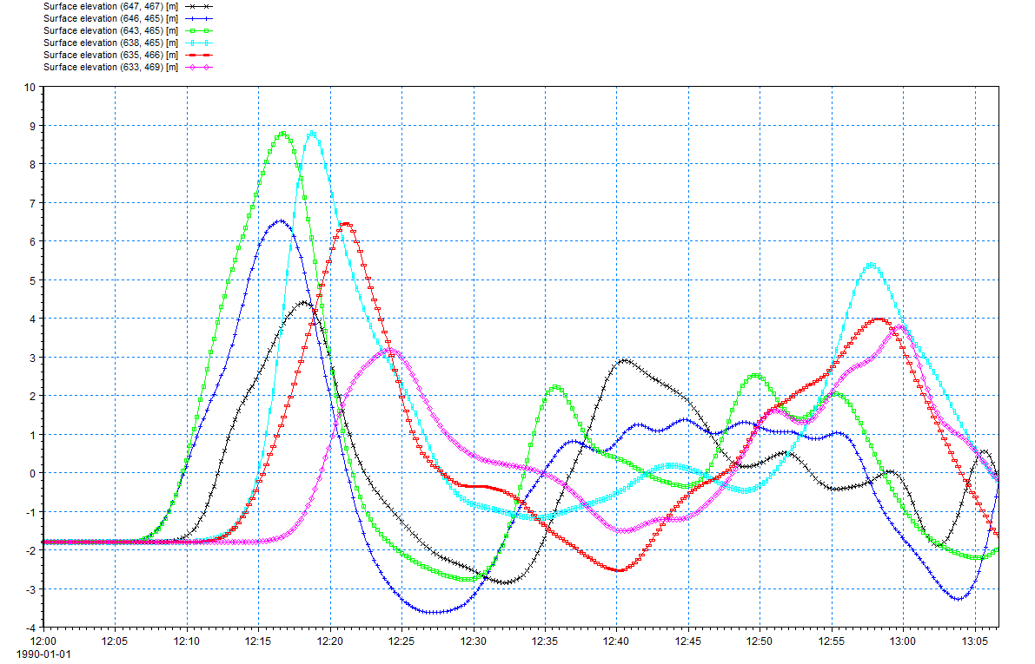
Tsunami Modeling
Result of Tsunami Propagation - Eastern Makran: Gwadar- Pakistan (8.8 MW)
9meter
17minutes

Slide 31
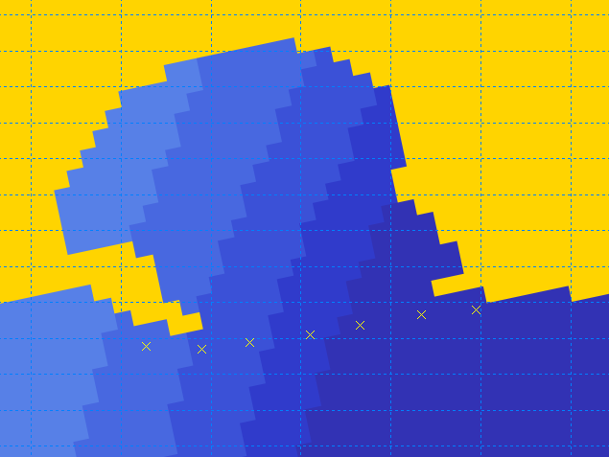
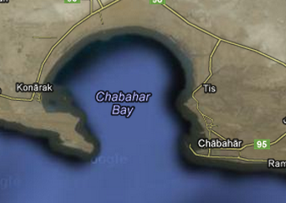
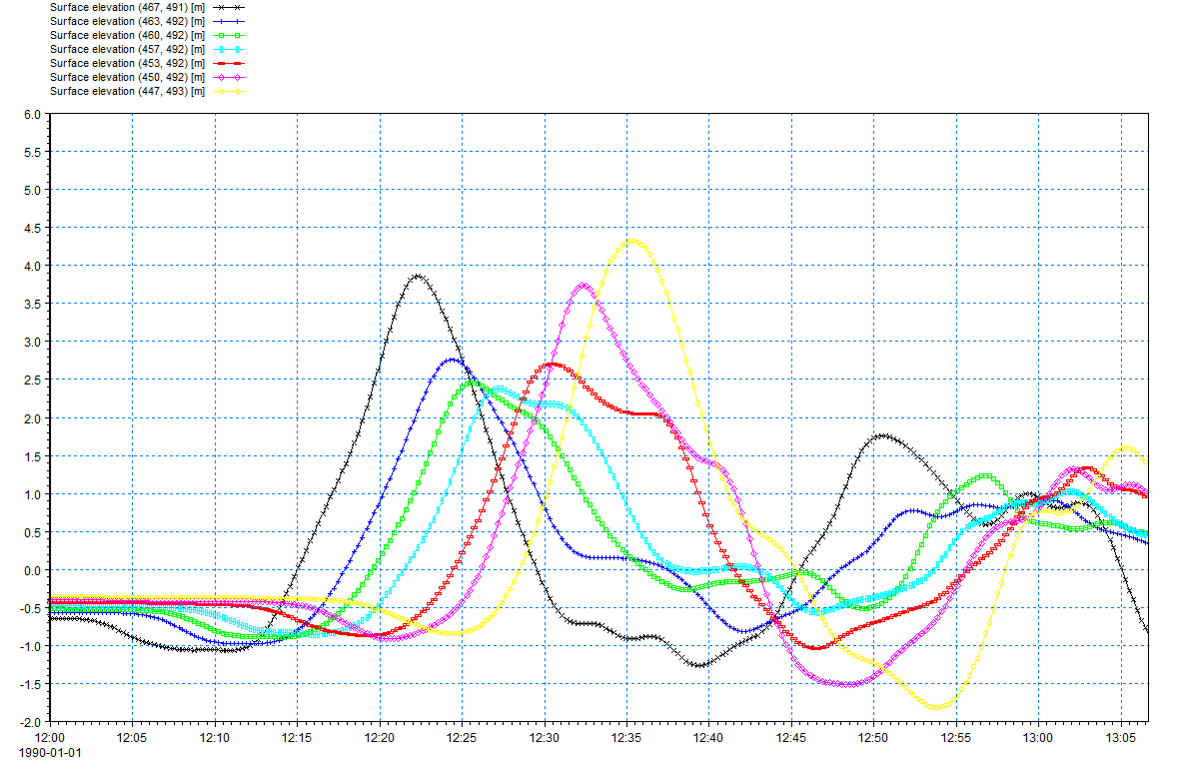
Tsunami Modeling
Result of Tsunami Propagation - Eastern Makran: Chabahar Bay-Iran (8.8 MW)
4.3meter
35minutes
3.9meter
22minutes

Slide 32
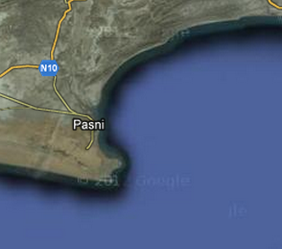
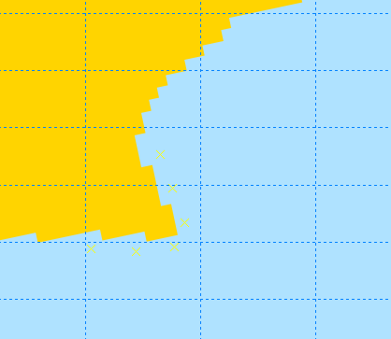
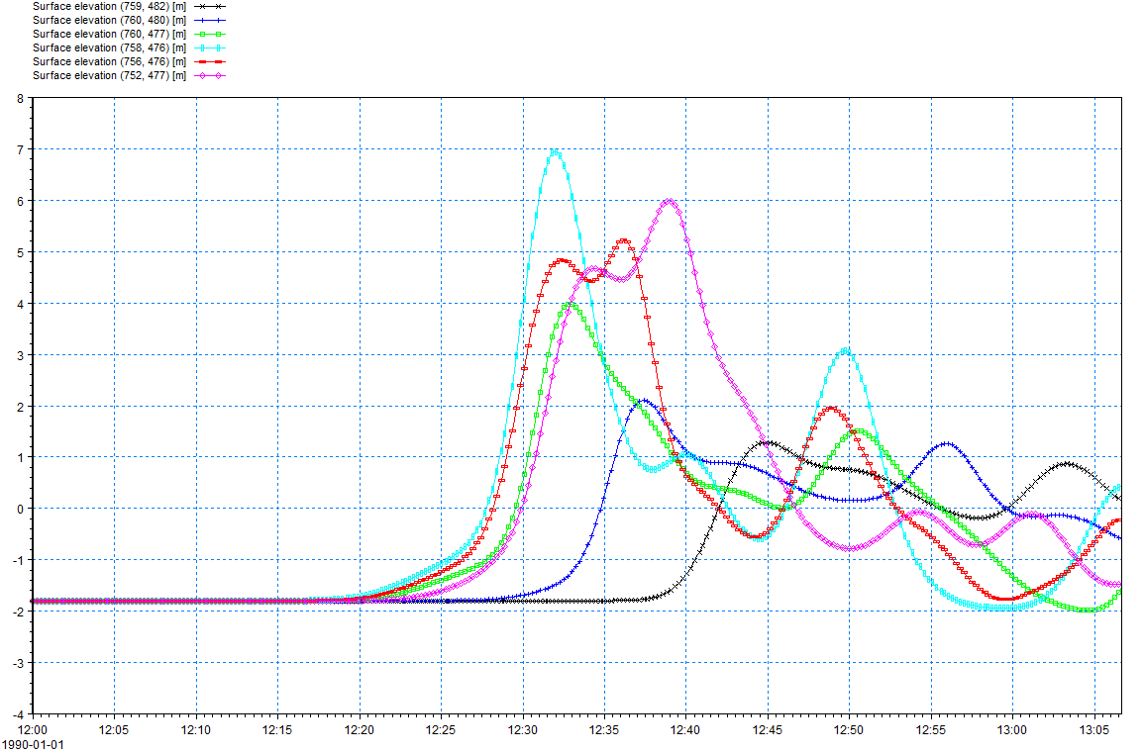
Tsunami Modeling
Result of Tsunami Propagation - Eastern Makran: Pasni-Pakistan (8.8 MW)
7meter
32minutes

Slide 33
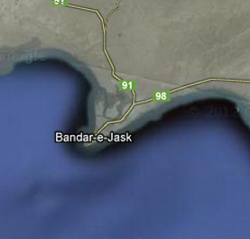
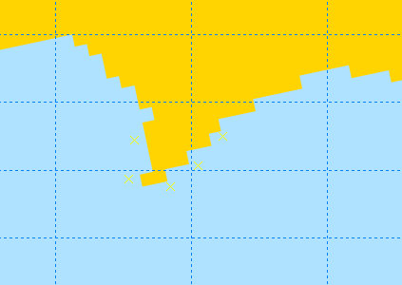
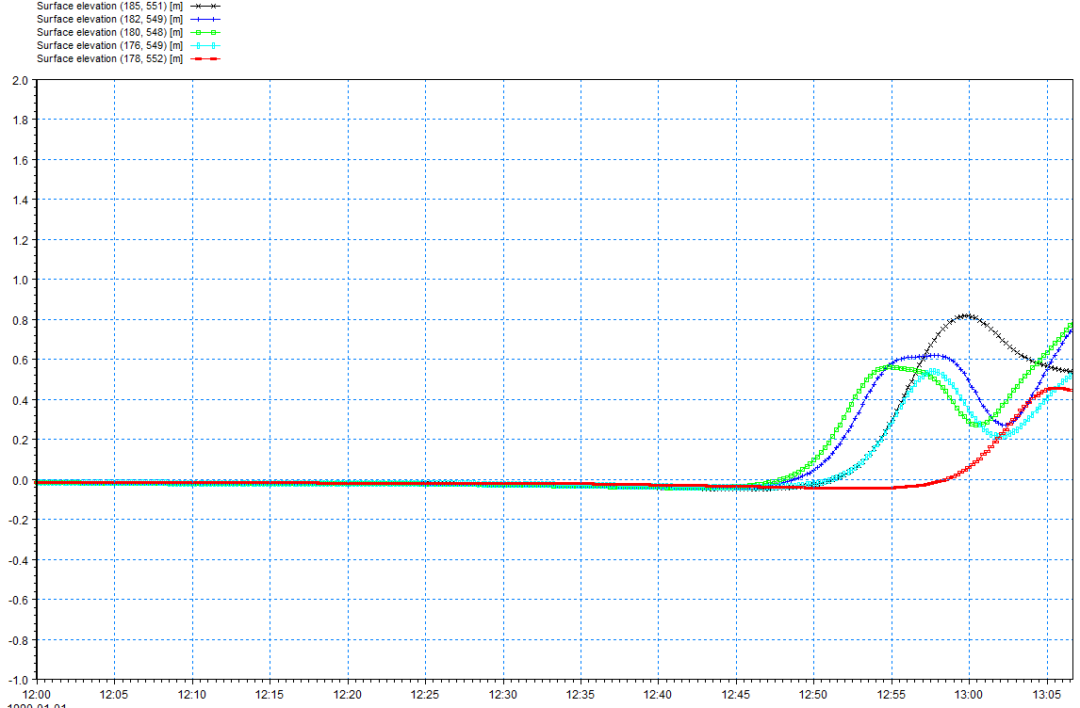
Tsunami Modeling
Result of Tsunami Propagation - Eastern Makran: Jask Port- Iran (8.8 MW)
0.8meter
60minutes

Slide 34
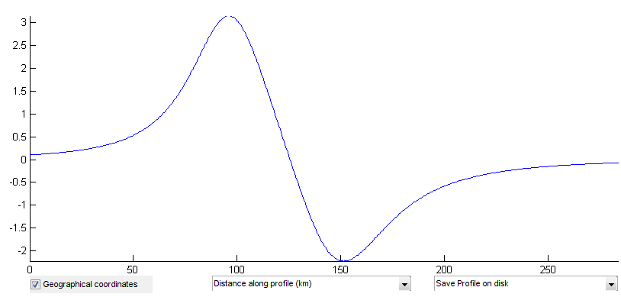
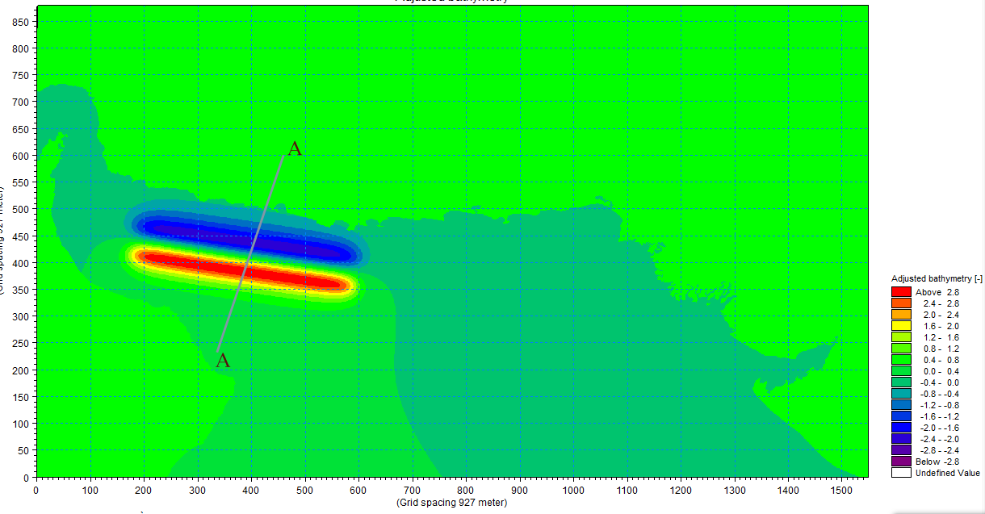
Tsunami Modeling
Second scenario: Propagation of tsunami-Earthquake magnitude:8.5 MW-Western Makran
Magnitude (Mw) | Length (km) | Width (Km) | Depth (Km) | Mean Dislocation (m) | Slip (Deg) | Dip (Deg) | Strike (Deg)
8.5 | 410 | 49.5 | 11 | 25 | 7 | 90 | 276.5
M
Km
The initial tsunami wave profile
Section A-A

Slide 35
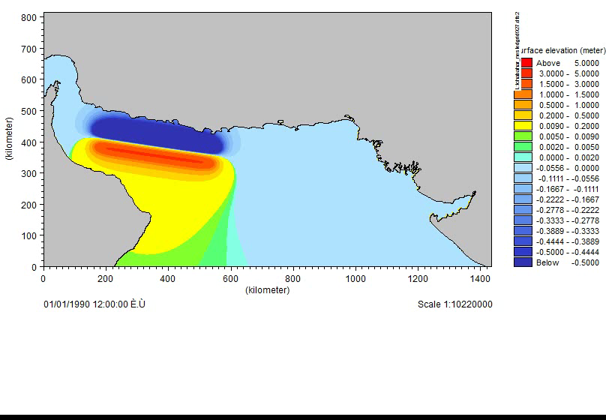
Tsunami Modeling
Tsunami Propagation Animation: Western Makran Subduction Zone

Slide 36
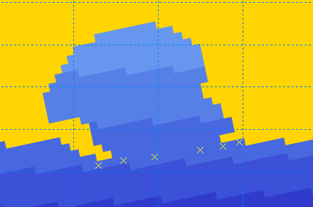
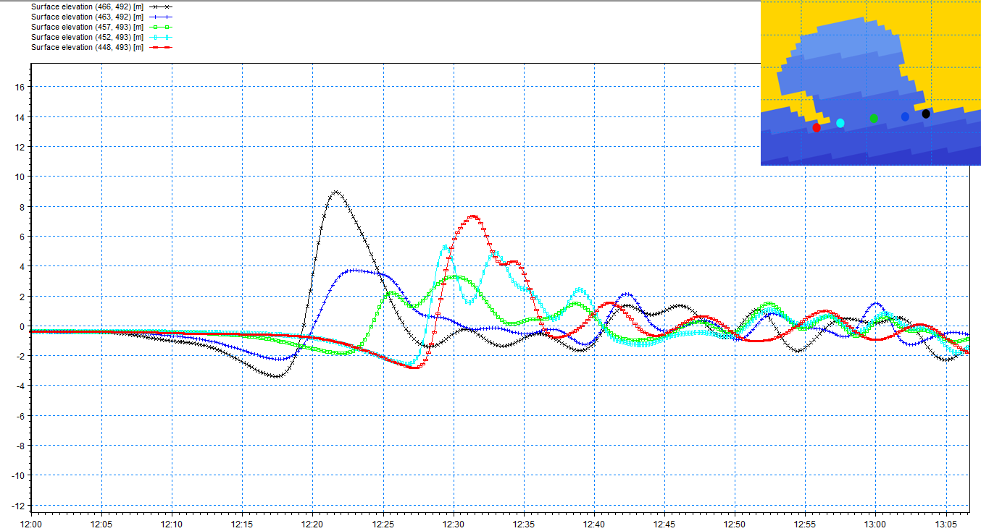
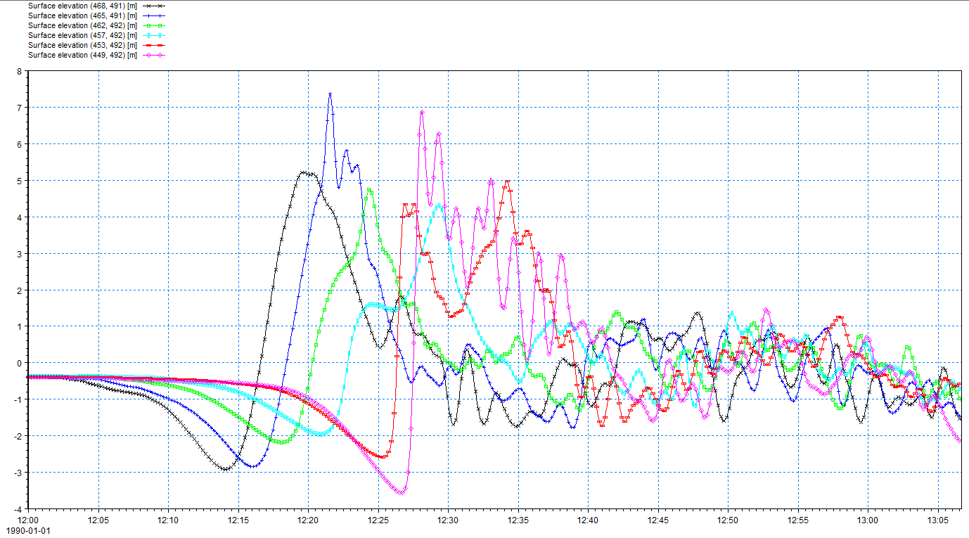
Tsunami Modeling
Result of Tsunami Propagation - Western Makran: Chabahar Bay-Iran (8.5 MW)
9meter
22minutes

Slide 37


Tsunami Modeling
Result of Tsunami Propagation - Western Makran: Gwadar- Pakistan (8.5 MW)
2.4meter
22minutes

Slide 38

Tsunami Modeling
Result of Tsunami Propagation - Western Makran: Pasni-Pakistan (8.5 MW)
0.5meter
55minutes

Slide 39


Tsunami Modeling
Result of Tsunami Propagation - Eastern Makran: Jask Port- Iran (8.5 MW)
3.4meter
36minutes
2.9meter
28minutes

Slide 40

Tsunami Modeling
Animation of Tsunami Created with MIKE Animator
Western Makran Senario (8.5MW) -Chabahar Bay, Iran

Slide 41


Tsunami Modeling
Verification of Tsunami Model
To verify tsunami modeling, two tsunami propagation scenarios – the 1945 Makran tsunami and the catastrophic tsunami in the east Makran region, studied by Heydarzadeh et al (2008) – were simulated using primary hydrodynamic parameters of Mike21 software. Based on observation, a good agreement was observed between the results of the propagation phase – and amplitude of tsunami waves hitting the coasts in both scenarios – and the results obtained from Mike 21 software.
(a)
(b)
Fig b) Maximum positive tsunami wave heights along various coasts. (Eastern Makran 8.8MW earthquake, Heydarzadeh et al (2008))

Slide 42

Strategy/Concluding Remarks

Slide 43

Strategy
First Strategy: Disaster Management with Tsunami Disaster Scenarios
Determine C-Scenario and P-Scenario: The keys to disaster management include assessment of disaster at present and disaster mitigation planning, which can be implemented by preparing two kinds of tsunami disaster scenarios:
one is for the current status of preparedness (C-Scenario)
the other for improved preparedness (Planned Scenario: P-Scenario).

Slide 44
Strategy
First Strategy: Disaster Management with Tsunami Disaster Scenarios
(C-Scenario): Tsunami disaster Scenarios for disaster management The tsunami disaster scenario for current preparedness is actually disaster assessment (risk assessment) in the current situation, which allows us to understand the existing risks including risks of casualties, damage to facilities and the impact on business.
(P-Scenario): The planned scenario of a disaster is actually disaster mitigation planning in which actual and concrete target levels of ‘Human Safety’, ‘Economic Loss’ and ‘Business Continuity’ are determined considering the costs and benefits. Measures to reach the target should be discussed and prepared including structural and non-structural countermeasures with
consideration of resilience.

Slide 45

Strategy
Second Strategy: Tsunami Hazard Mapping
A tsunami hazard map graphically shows damage-prone areas with expected degrees of damage caused by possible tsunamis. Tsunami-affected zones in a specific area are estimated by analysis of historical damages due to tsunamis striking the area in the past and by numerical simulations based on tsunami scenarios. The most fundamental and widespread information of tsunami damage is where the tsunami is expected to cause flooding and inundation. Coloring these areas on a map provides a simple and good indication of the necessity of evacuation. A map discriminating degrees of inundation depth as well as inundation areas can further increase understanding of tsunami damage risk. Based on such a map, measures can be established to reduce the critical inundation depth of objects or structures which should be protected against tsunamis.

Slide 46

Strategy
    Third Strategy: Management of Boats and ships in ports
This table shows possible countermeasures to be taken by ships against tsunamis. Proposed by the Japan Association of Marine Safety, the actions are depending on the tsunami height, available time, ship size, and the state of the ship. According to this table, the principal actions that can be taken are to evacuate to a deep and wide offshore area and to moor a ship with many long mooring ropes.

Slide 47

Strategy
    Third Strategy: Management of Boats and ships in ports
The best way to keep a ship undamaged by a tsunami is to have it evacuate outside the port. However, this method can be applied only if there is enough time before the arrival of a tsunami.
The Japan Association of Marine Safety suggests the preparation of a port version of hazard maps, which indicate the predicted situation of a tsunami attack in a harbor basin. The degree of risk according to the location of a ship can be grasped from the hazard map, and the measures designated in the ship action table against tsunami can be taken based on a tsunami forecast. A ship action table against tsunami like Previous Page Table and a hazard map like should be prepared for each port with regard to its specific conditions.
hazard map for the Port of Shimizu.

Slide 48
Strategy
    Forth Strategy: tsunami warning system
Tsunami Warning System (TWS) is used to detect tsunamis in advance and issue warnings to prevent loss of life and damage. It is made up of two equally important components: a network of sensors to detect tsunamis and a communications infrastructure to issue timely alarms to permit evacuation of the coastal areas.

Slide 49

Strategy
    Forth Strategy: tsunami warning system
Introduction of two tsunami warning system devices:
Earthquake Early Warning system (EEW system):
which quickly determines the hypocenter and the magnitude from the seismic waveform data observed at seismic stations near the hypocenter, and transmits warnings with estimated seismic intensity and arrival time of strong ground motion in each region before the strong ground motion arrives. This technique is also expected to contribute to reducing the elapsed time for the issuance of tsunami warning. JMA applies the EEW technique to tsunami warning to be issued in 2 minutes at earliest after the occurrence of the earthquake.

Slide 50

Strategy
    Forth Strategy: tsunami warning system
2. DART (Deep-ocean Assessment and Reporting of Tsunamis):
system consists of a seafloor bottom pressure recording (BPR) system capable of detecting tsunamis as small as 1 cm, and a moored surface buoy for real-time communications. An acoustic link is used to transmit data from the BPR on the seafloor to the surface buoy. The data are then relayed via a GOES satellite link to ground stations, which demodulate the signals for immediate dissemination to NOAA's Tsunami Warning Centers.

Slide 51
Concluding Remarks
In March 2011, the devastating Tohoku tsunami caused failure of defense structure due to a complete lack of understanding of fault activity and incorrect estimate of earthquake prediction. In absence of information on Makran fault mechanism, it is difficult or impossible to design structures that are capable of dealing with tsunami. Hence, the best way to minimize the effects of the probable tsunami strike on harbor and coastal facilities is to undertake disaster management policies to secure people and reduce the economic loss and business flow. Thus, all the harbor personnel should be familiar with tsunami hazards and learn the experience obtained from different ports of the world, including Japan.
Tsunami early warning system can not normally announce the warning in case of occurrence a local tsunami (such as Makran subduction zone), so the best warning of the approach of a tsunami following a large local earthquake is the earthquake itself. Should a strong earthquake be felt at medium strength for what seems to be a long period, coastal people should prepare for a tsunami. The tsunami may follow immediately after the earthquake, or up to about an hour later. Sometimes, the first indication of the tsunami is the sea receding from the shore, exposing normally covered coral reefs. The rise in sea level then follows.

Slide 52
Concluding Remarks
Due to the tsunami wave arrival time (15 to 30 minutes) to Iranian coastal areas such as Chabahar bay (if an earthquake with a moment magnitude of 8.5 MW occurs in western Makran region), tsunami warning system can be effective in saving lives if it announced warning within 5 to 7 minutes.
We also have two research stations equipped with automatic water level changes measure system in Jask port and Chabahar bay that has been launched by National Pacific to monitor the Makran fault condition.

Slide 53
Recommendations
In order to overcome the shortcomings of present study, the following suggestions are made ​​ in future modeling study:
1. Use bathymetry and topography data with an accuracy of approximately 10m to 90m in order to obtain accurate incoming tsunami profiles in major harbors and coastal areas such as Chabahar Bay and Beris port.
2. Model overtopping of tsunami wave over a coastal structures in major harbors and coastal areas.
3. Model flooded area and Prepare Evacuation maps of people/ships for ports and coastal areas of Iran if tsunami occurs.

